Slide 1
Thinking Swift

Slide 2
Catalog
Basic Syntax
Data Types
Variables & Tuples
Operators
Decision Making
Loops
Strings
Characters
Arrays
Dictionaries
Functions
Structures
Classes
Access Control

Slide 3
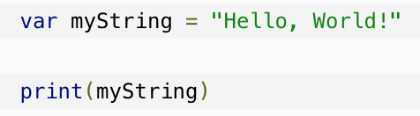




Basic Syntax
Import framework or library
import Cocoa
Comments
Single-line comments //
Multi-line comments /* my comments */
Semicolons
Identifiers
An identifier starts with an alphabet A to Z or a to z or an underscore _ followed by zero or more letters, underscores, and digits (0 to 9).
Whitespaces

Slide 4
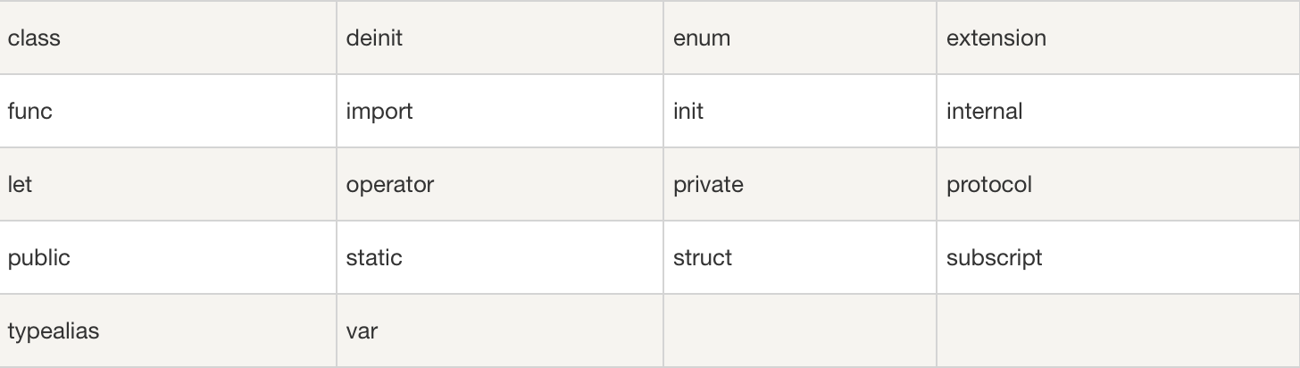
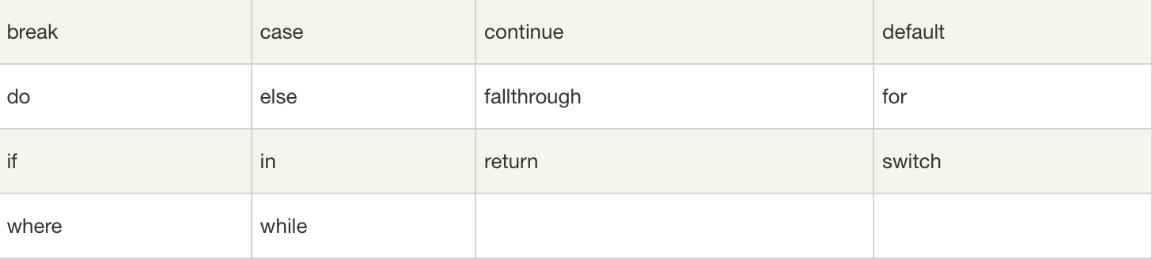
Keywords

Slide 5
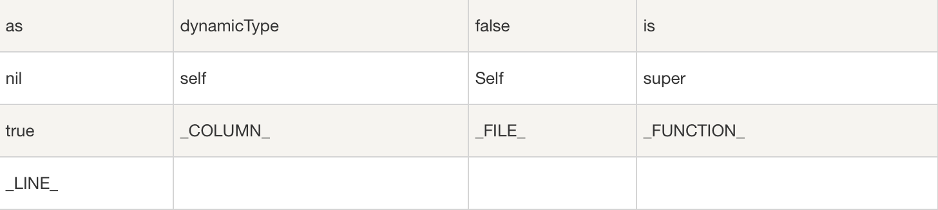
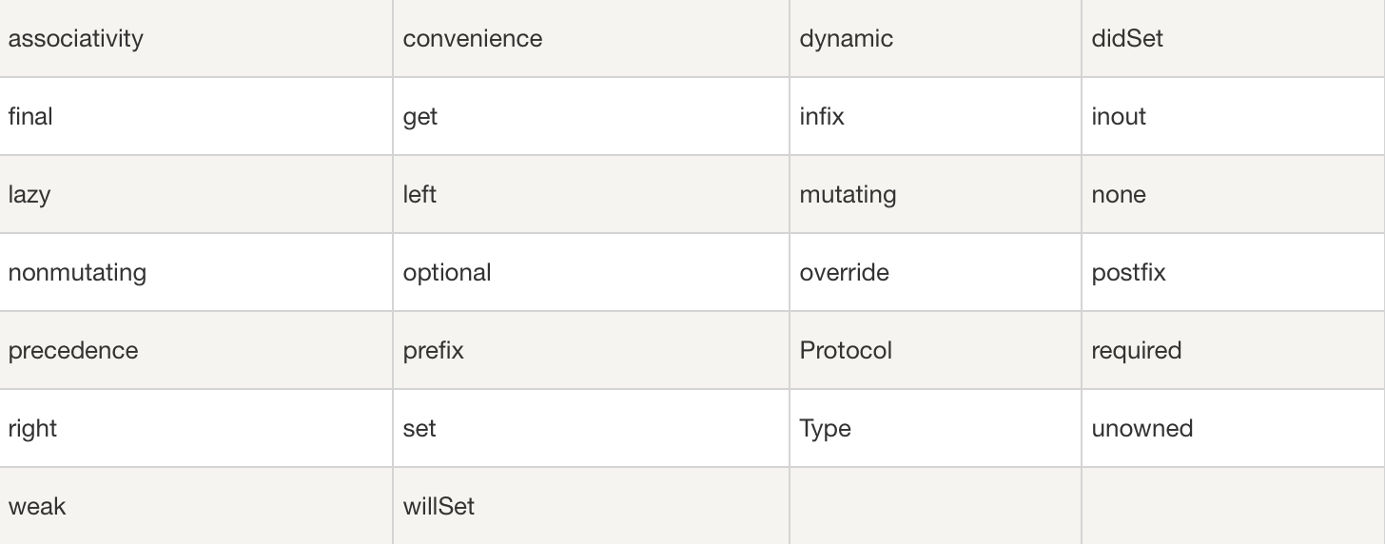

Slide 6
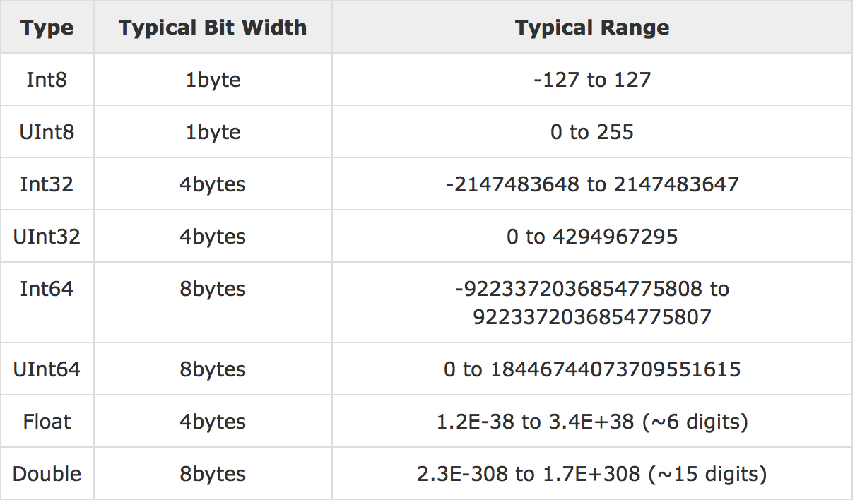
Data Types
Bound Values

Slide 7
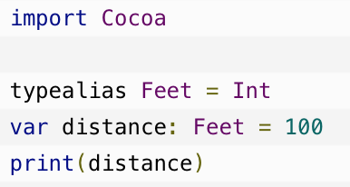
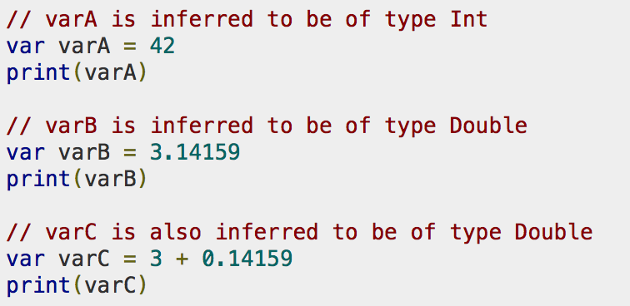
Type Aliases
typealias newname = type
Type Safety
var varA = 42; varA = "This is hello"
Type Inference

Slide 8
Variables & Tuples
Variables
var constantName:<data type> = <optional initial value>
Tuples
let constantName :<data type> = <optional initial value>

Slide 9
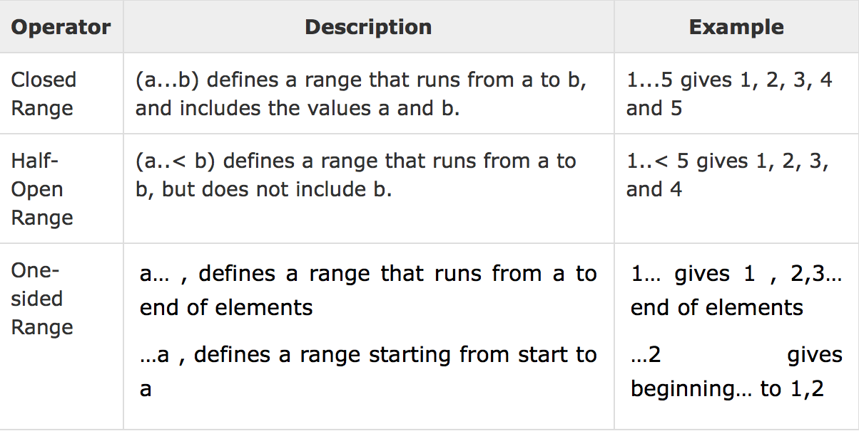
Operators
Arithmetic Operators
Comparison Operators
Logical Operators
Bitwise Operators
Assignment Operators
Range Operators
Misc Operators

Slide 10
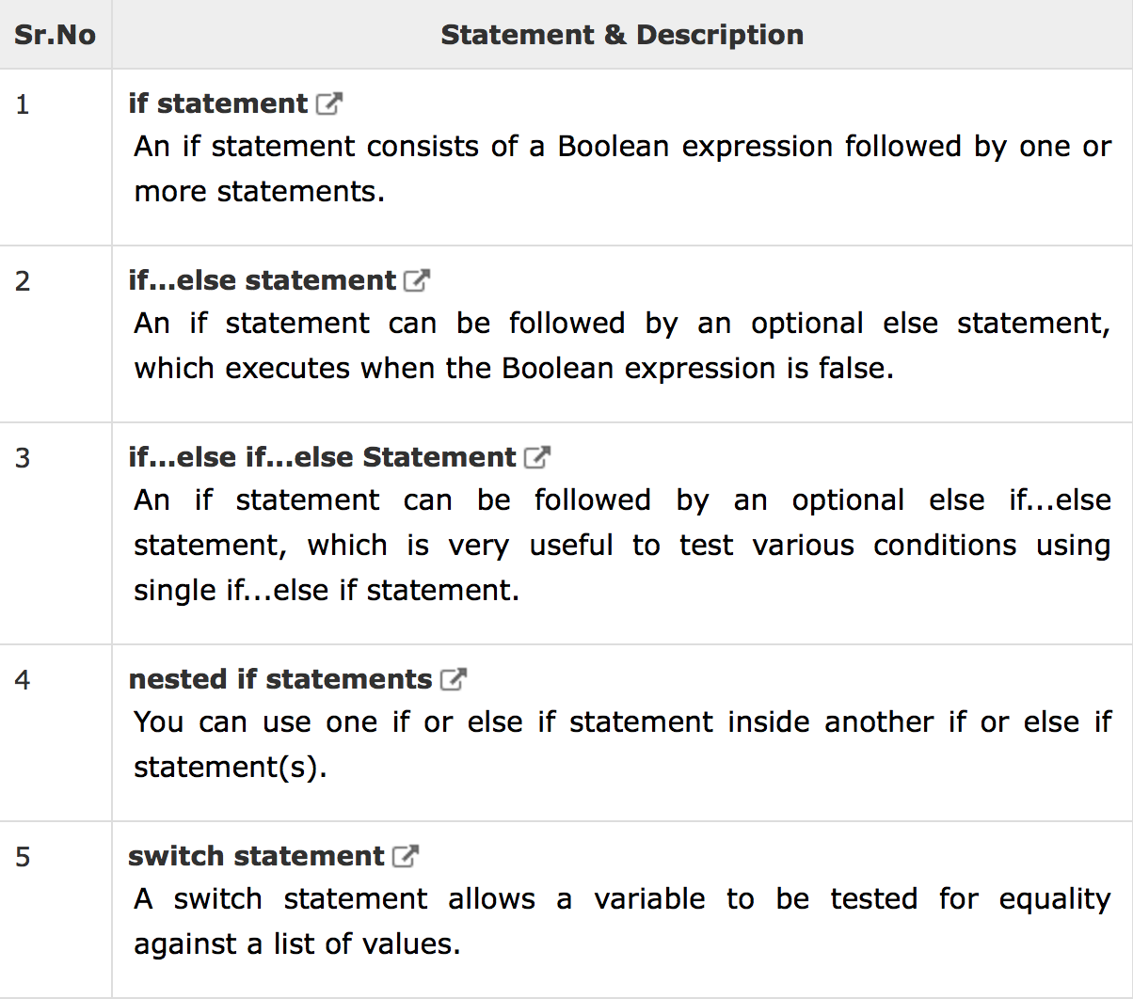
Decision Making

Slide 11
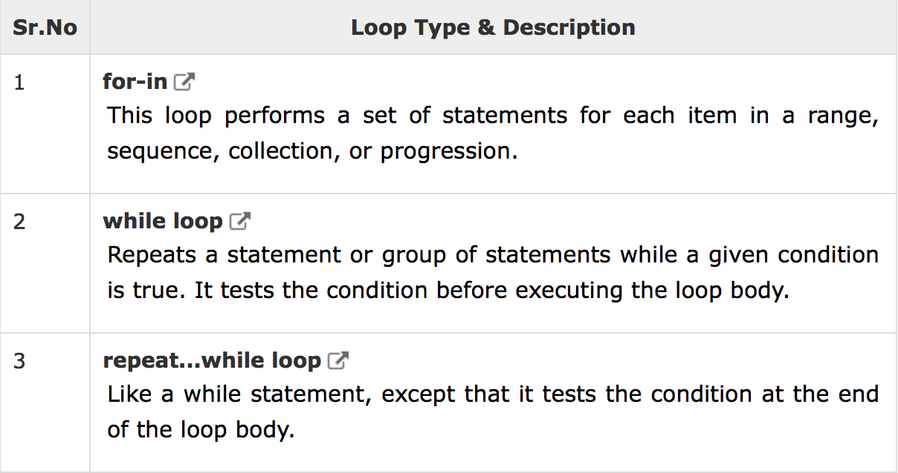
Loops
Loops

Slide 12
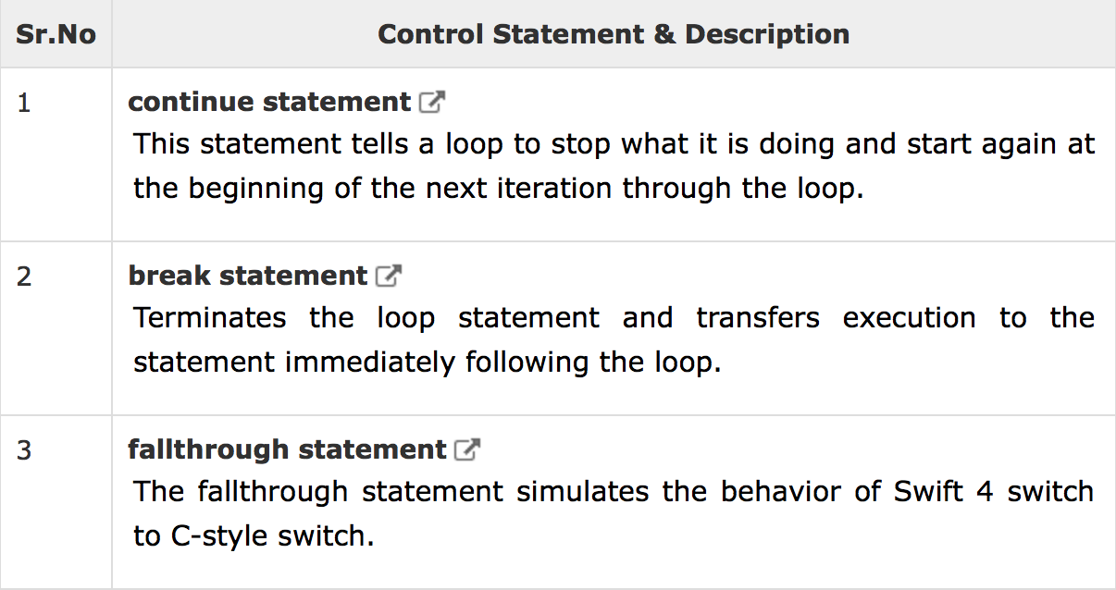
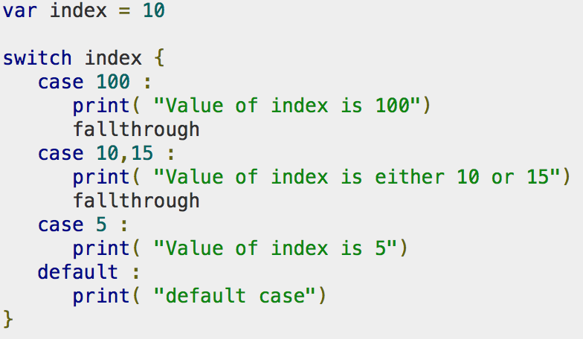
Loop Control Statements

Slide 13
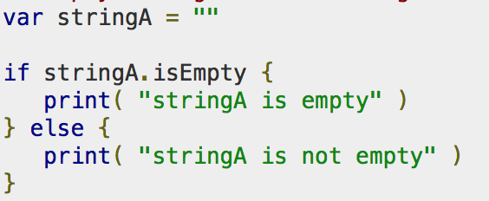
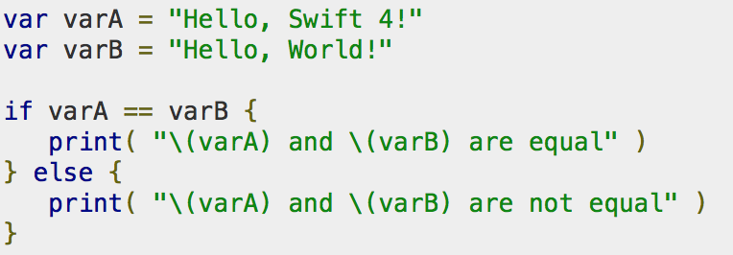
Strings
Empty String
String Concatenation
var stringA = constA + constB
String Interpolation
var stringA = "\(varA) times \(constA) is equal to \(varC * 100)”
String Length
var varA = ”Hello”; print("\(varA.characters.count)")
String Comparison

Slide 14
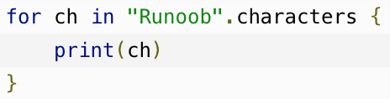
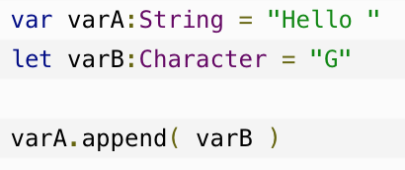
Characters
Characters
let char1: Character = "A"
Empty Character Variables
It is not possible to create an empty Character variable or constant which will have an empty value.
Accessing Characters from Strings
Concatenating Strings with Characters

Slide 15
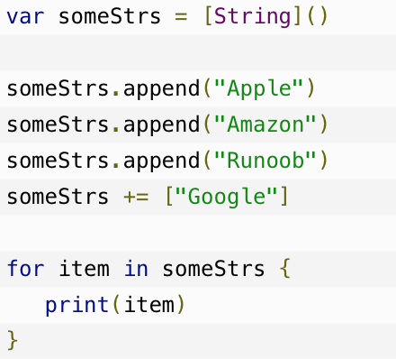
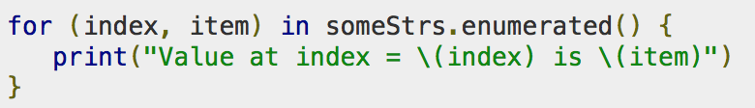
Arrays
Creating Array
var someArray = [SomeType](repeating: InitialValue, count: NumbeOfElements)
var someInts = [Int](repeating: 0, count: 3)
var someInts:[Int] = [10, 20, 30]
Modifying Array
someInts.append(20)
someInts += [40]
someInts[2] = 50
Iterating Over an Array

Slide 16
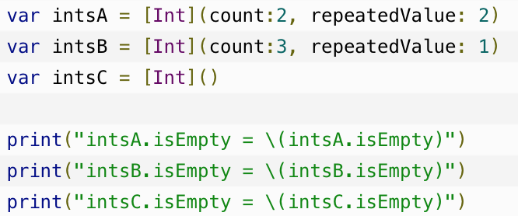
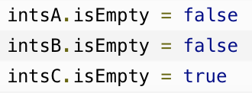
Adding Two Arrays
var intsC = intsA + intsB
The count Property
intsA.count
The empty Property

Slide 17
Dictionaries
Creating Dictionary
var someDict = [KeyType: ValueType]()
var someDict:[Int:String] = [1:"One", 2:"Two", 3:"Three"]
Modifying Dictionaries
someDict.updateValue(”new value", forKey: 1)
someDict[1] = ”new value"
Remove Key-Value Pairs
someDict.removeValue(forKey: 2)
someDict[2] = nil
Iterating Over a Dictionary
for (key, value) in someDict
for (key, value) in someDict.enumerate()

Slide 18
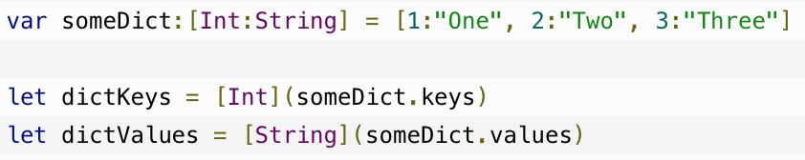
Convert to Arrays
The count Property
someDict1.count
The empty Property
someDict1.isEmpty

Slide 19
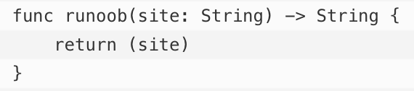
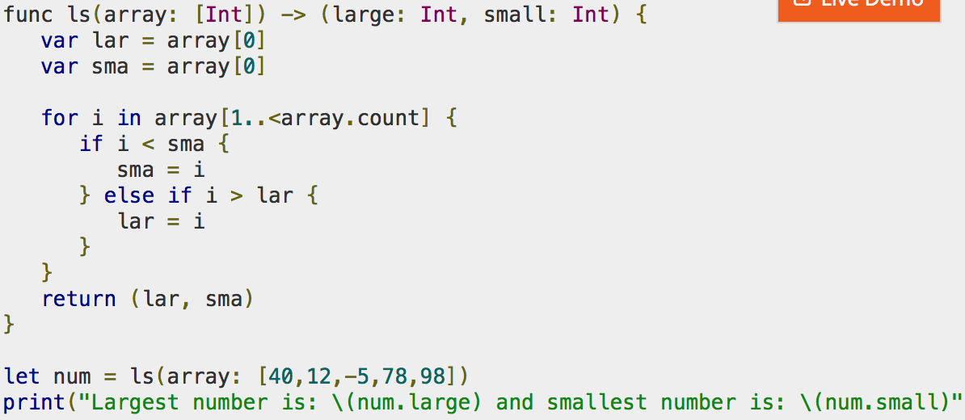
Functions
Function Definition
Functions with Return Values

Slide 20
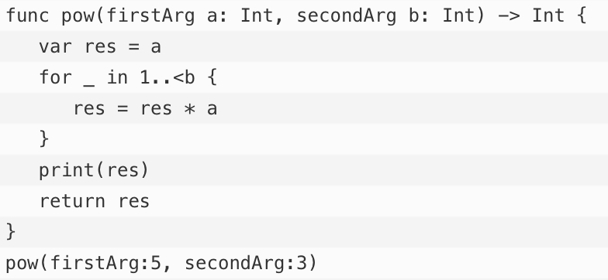
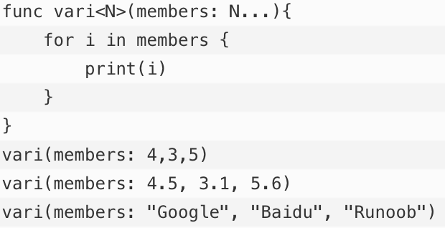
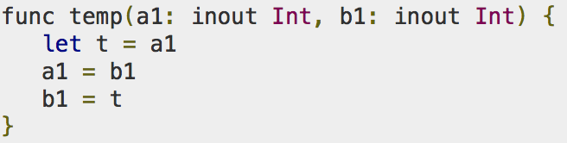
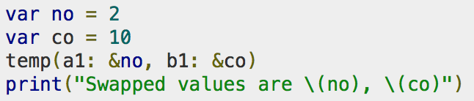
External Parameter Names
Variadic Parameters
I/O Parameters

Slide 21
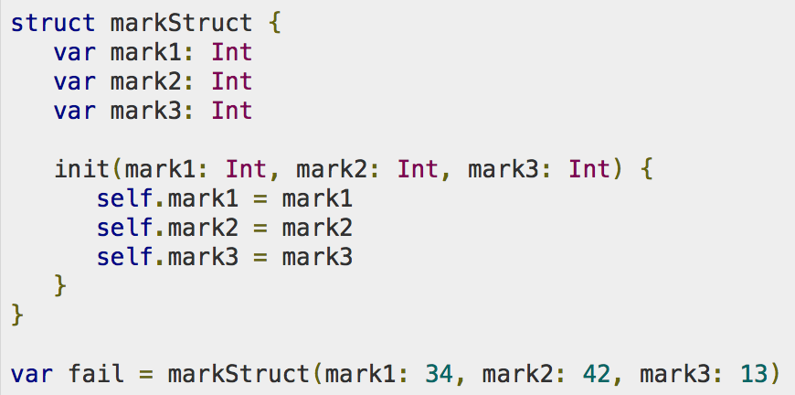
Structures
Definition of a Structure

Slide 22
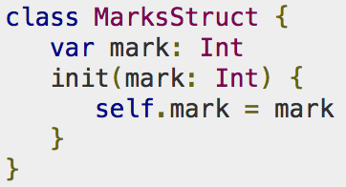
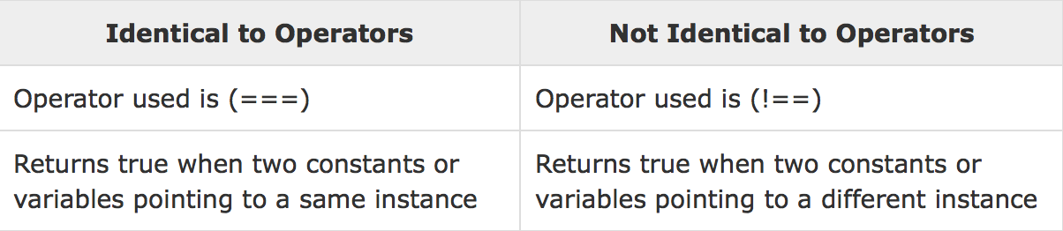
Classes
Class Definition
Self property in Methods
Methods have an implicit property known as 'self' for all its defined type instances. 'Self' property is used to refer the current instances for its defined methods.
Class Identity Operators

Slide 23
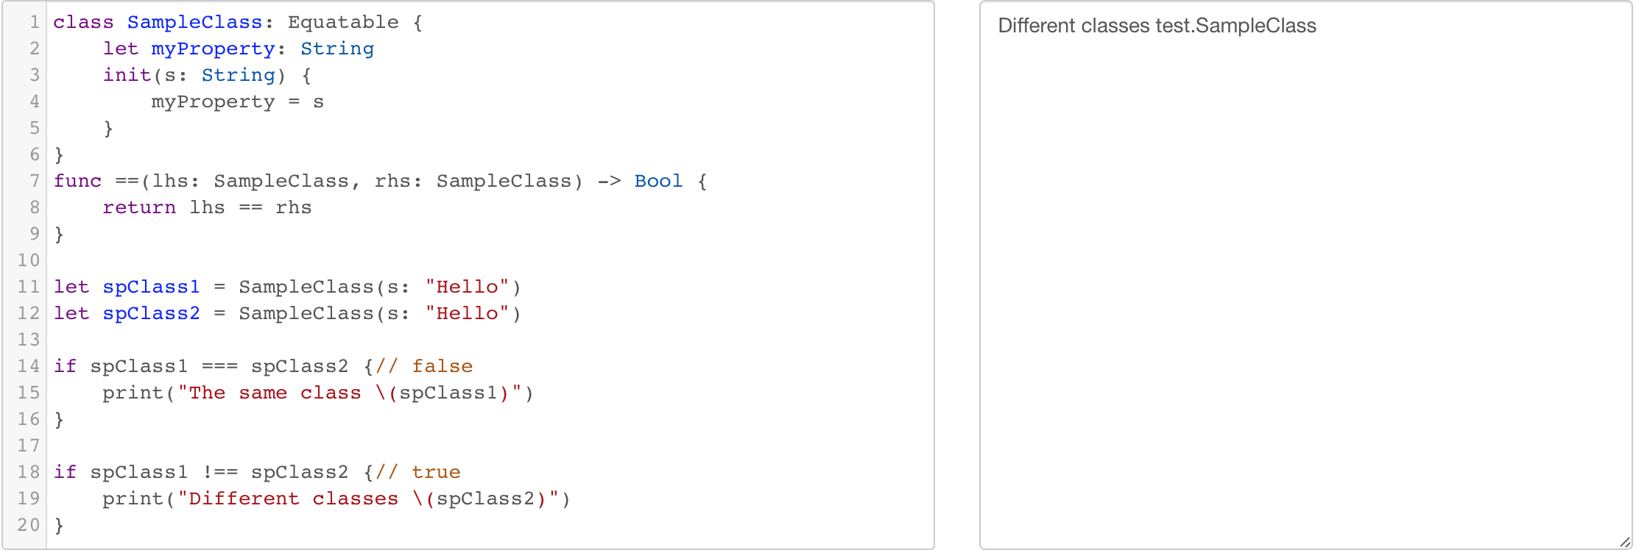

Slide 24
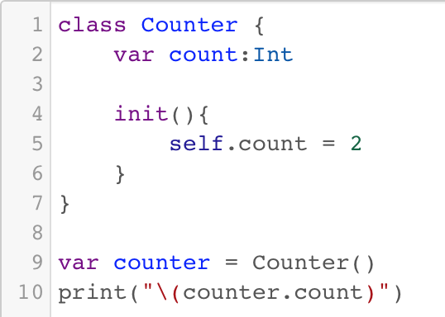
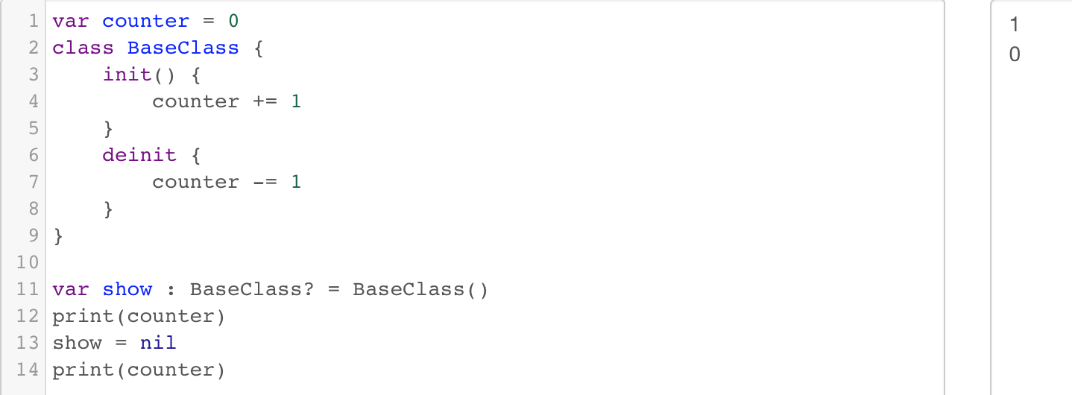
init
deinit

Slide 25
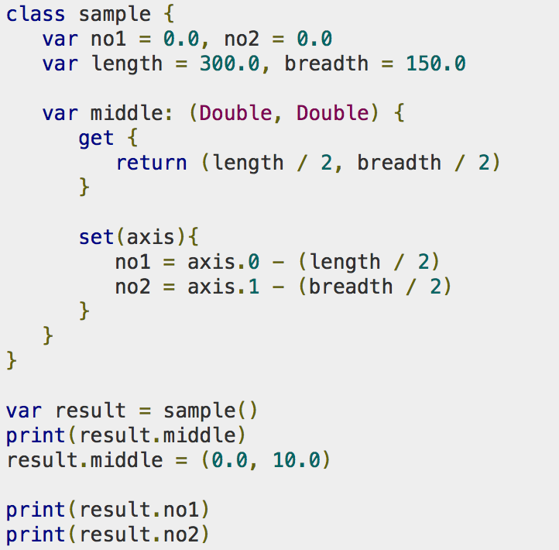
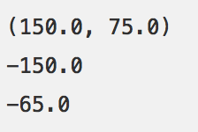
Computed Properties
Rather than storing the values computed properties provide a getter and an optional setter to retrieve and set other properties and values indirectly.

Slide 26
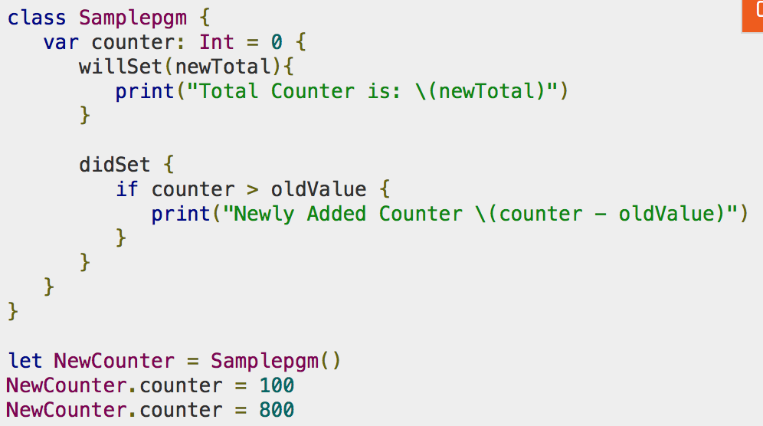
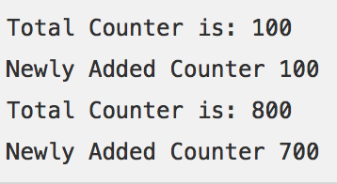
Computed Properties as Property Observers
Before Storing the value - willset
After Storing the new value - didset
When a property is set in an initializer willset and didset observers cannot be called.

Slide 27
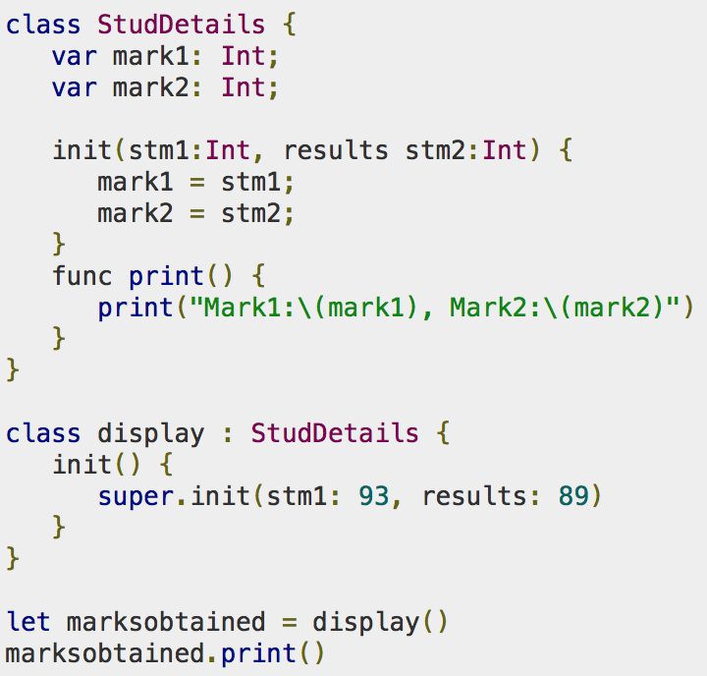

Subclass
The act of basing a new class on an existing class is defined as 'Subclass'. The subclass inherits the properties, methods and functions of its base class. To define a subclass ':' is used before the base class name

Slide 28
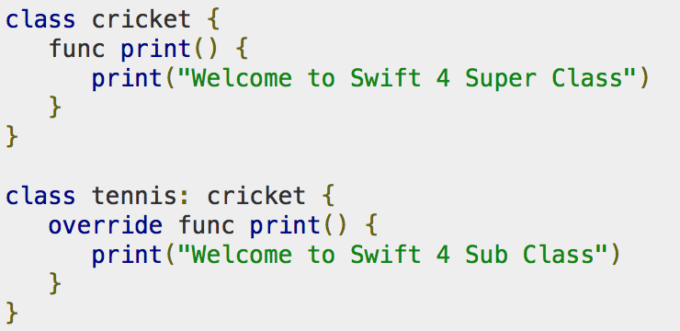
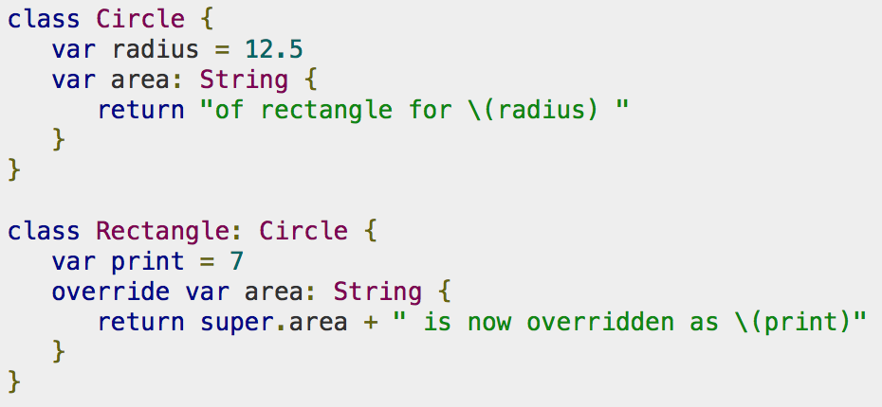
Overriding
Key word: override
Methods Overriding
Property Overriding

Slide 29
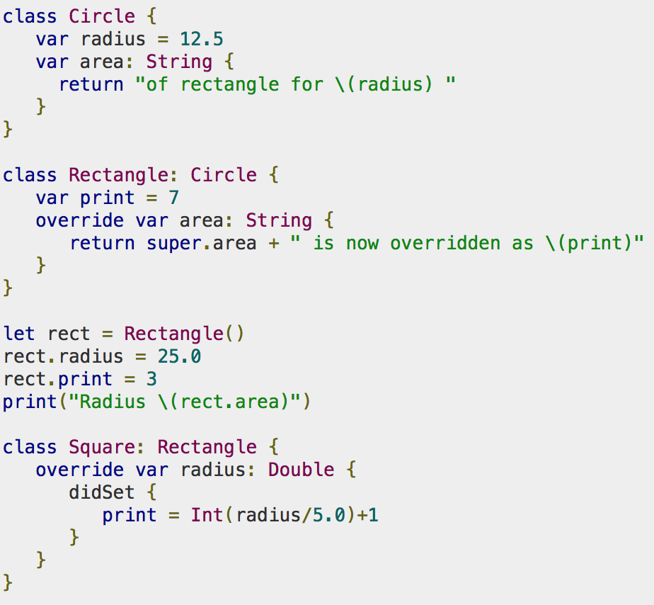
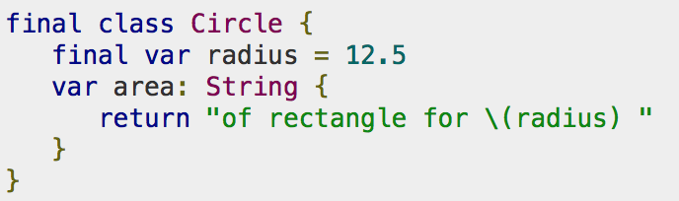
Overriding Property Observers
Final Property to prevent Overriding

Slide 30
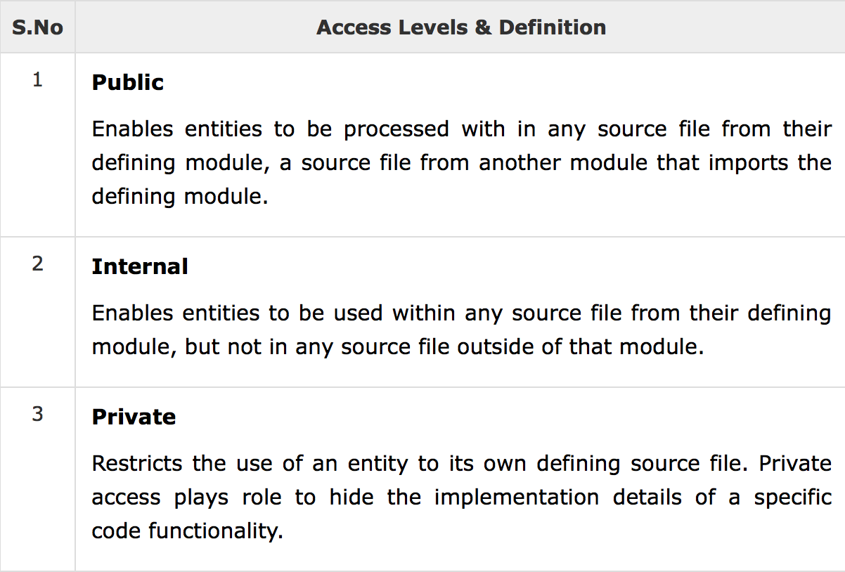
Access Control
Module is defined as a single unit of code distribution and can be imported using the keyword 'import'. A source file is defined as a single source code file with in a module to access multiple types and functions.

Slide 31
Gracias

